Slide 1



Global Terrorism Analysis & Severity Prediction
NSH Predictors | Data & AI Team

Slide 2

CONTENTS
1. Title Slide
2. Introduction
3. About the Dataset
4. Data Cleaning & Preprocessing
5. Exploratory Data Analysis (EDA) - Key Insights
6. Machine Learning Approach
7. Regression Model Results
8. Classification Model Results
9. Conclusion
10. Future Work
11. Q&A / Thank You Slide

Slide 3

01
Title Slide

Slide 4


Title Slide
1
Title
2
Subtitle
"Global Terrorism Analysis & Severity Prediction"
“Analyzing the Past, Informing the Future”
3
Team Name
4
Team Members
NSH Predictors | Data & AI Team
Navdeep, Sahil, Hariom
5
Course
6
Institution
Data Science with Python
World College of Technology & Management, Gurgaon

Slide 5

02
Introduction

Slide 6

Introduction
Terrorism is a big problem that affects people all over the world. It's when groups use violence, like bombings or shootings, to scare people and achieve their goals. This violence causes a lot of harm, hurting innocent people and making communities feel unsafe. It's a challenge because it can happen anywhere, and it's hard to predict when and where it will strike. Our project uses data to try and understand these attacks better, so we can hopefully make communities safer.
Global Challenge of Terrorism

Slide 7



Introduction
Project Core Purpose
Problem Statement
Objectives
• Clearly articulate the two main goals (EDA and ML for casualty prediction).
Find Patterns
Understand Attacks
Identify Groups
Predict Severity
• Understanding patterns and predicting severity.

Slide 8

03
About the Dataset

Slide 9

Dataset Information
1
Source: Global Terrorism Database (GTD)
2
Key facts: >180,000 attacks (1970-2017, except 1993), worldwide coverage, >100 variables.
3
Briefly mention the GTD's definition of terrorism.

Slide 10

04
Data Cleaning & Preprocessing

Slide 11

Data Cleaning & Preprocessing
Initial Challenges
• 135 columns, missing values, inconsistent naming.
Key Steps
• Column renaming (e.g., iyear to Year, nkill to Fatalities).
• Selection of relevant features (mention the reduced set for ML).
• Handling missing values (e.g., filling 0 for casualties, 'Unknown' for categories).
• Creation of Total_Casualties feature.

Slide 12
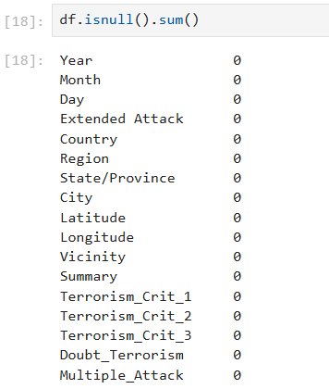
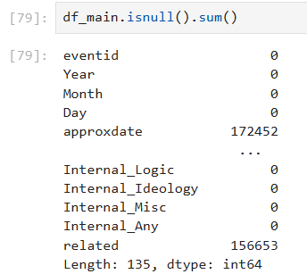
Data Cleaning & Preprocessing
Impact of Data Cleaning

Slide 13

05
Exploratory Data Analysis (EDA) - Key Insights

Slide 14


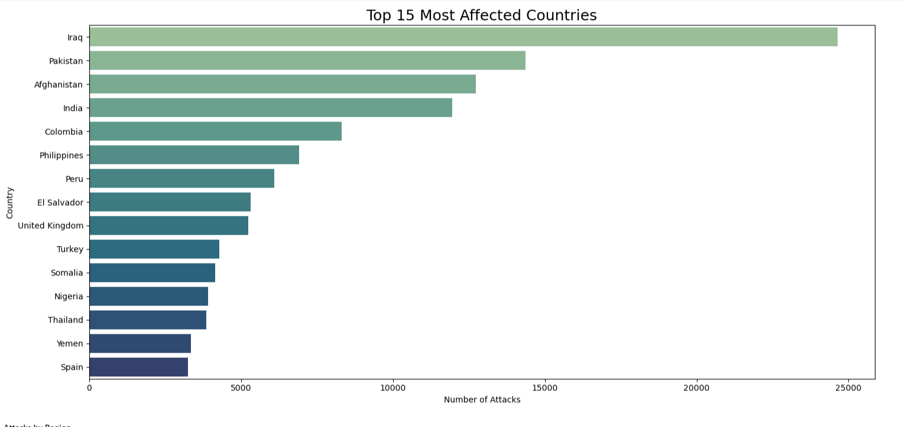
Exploratory Data Analysis (EDA) - Key Insights
Global Trends & Hotspots
• Top 15 Most Affected Countries (Bar chart).
Key Insights:
Iraq is Overwhelmingly the Most Affected
South Asia is Highly Impacted

Slide 15
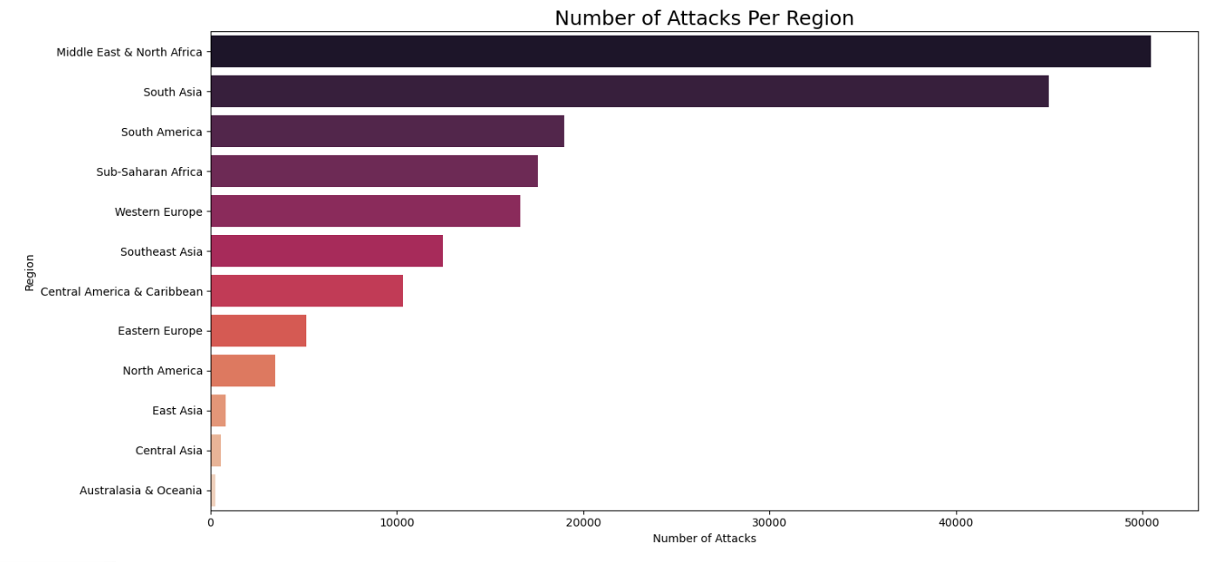
Exploratory Data Analysis (EDA) - Key Insights
Global Trends & Hotspots
• Region with the most attacks (Middle East & North Africa).
Key Insights:
Middle East & North Africa (MENA) is the Primary Hotspot
South Asia is a Close Second
Relatively Low Impact in Some Regions

Slide 16
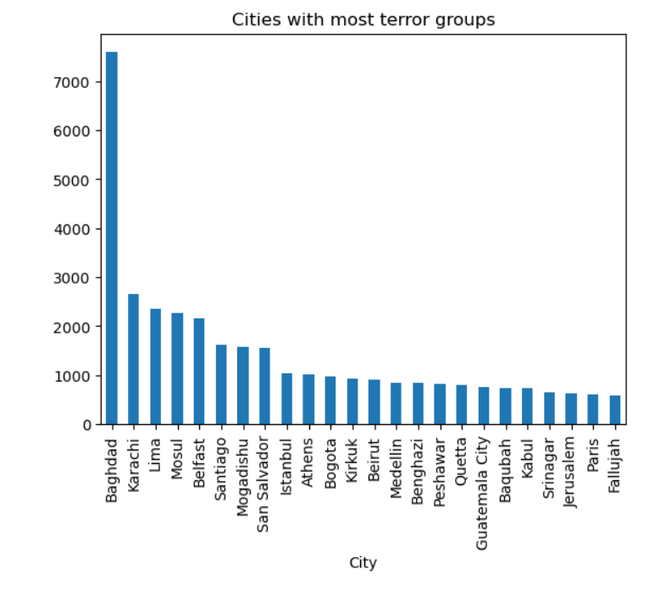
Exploratory Data Analysis (EDA) - Key Insights
Global Trends & Hotspots
• Cities with most terror groups
Key Insights:
Baghdad is a Major Nexus for Terrorist Groups

Slide 17
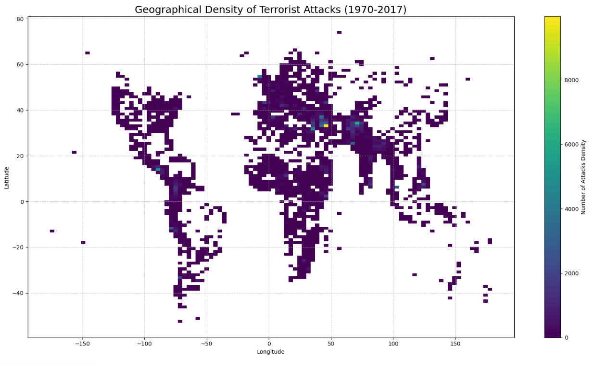
Exploratory Data Analysis (EDA) - Key Insights
Global Trends & Hotspots
Distribution of Attacks (Latitude & Longitude)
Key Insights:
Dominance of the Middle East
Significant Activity in South Asia
Uneven Global Distribution

Slide 18
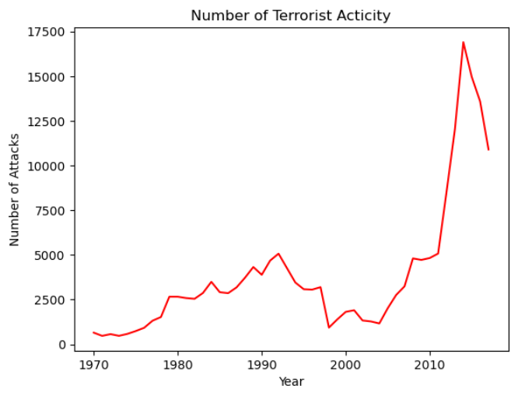
Exploratory Data Analysis (EDA) - Key Insights
Temporal Evolution of Terrorism
• Attacks Over Time (Yearly) Line Graph
Key Insights:
Relatively Low Activity in Early Decades
Gradual Increase to the 1990s
Dramatic Surge in the 21st Century
Peak in 2014
Slight Decline After Peak

Slide 19
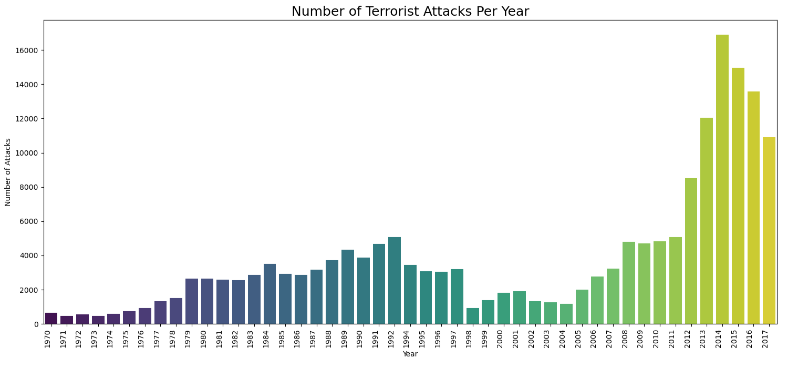
Exploratory Data Analysis (EDA) - Key Insights
Temporal Evolution of Terrorism
• Attacks Over Time (Yearly) Bar Plot
Key Insights:
Low Activity in Earlier Decades
Gradual Increase and Plateau in the Late 80s/Early 90s
Explosive Growth in the 21st Century

Slide 20
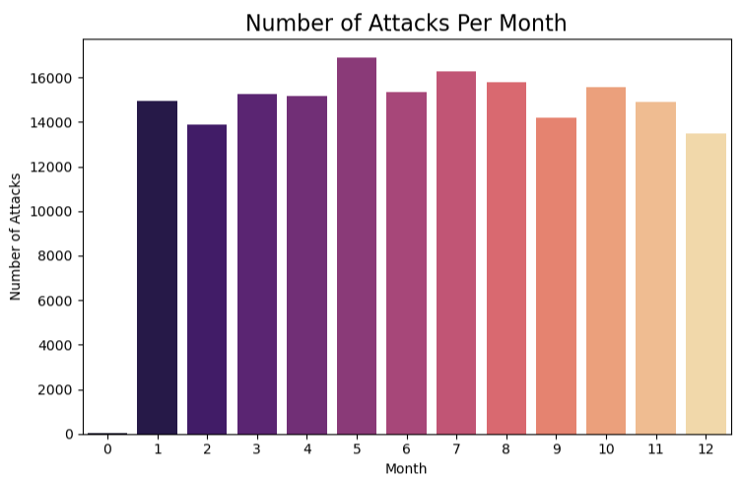
Exploratory Data Analysis (EDA) - Key Insights
Temporal Evolution of Terrorism
• Attacks by Months (Overall)
Key Insights:
Relatively Consistent Activity Throughout the year.
Slight Peaks in Spring/Summer
Slight Dip Towards Year-End

Slide 21
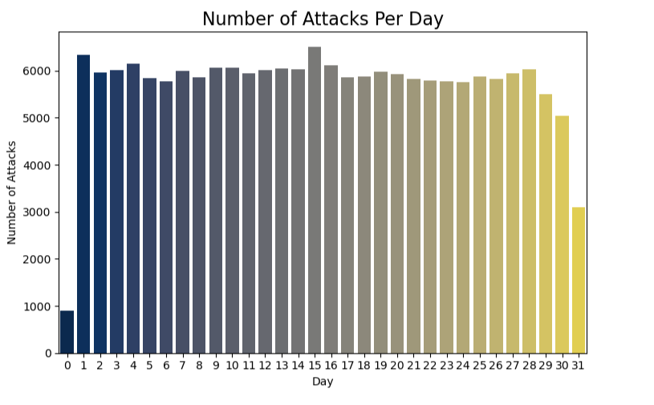
Exploratory Data Analysis (EDA) - Key Insights
Temporal Evolution of Terrorism
• Attacks by Days (Overall)
Key Insights:
Generally Even Distribution
No Major Daily Spikes

Slide 22
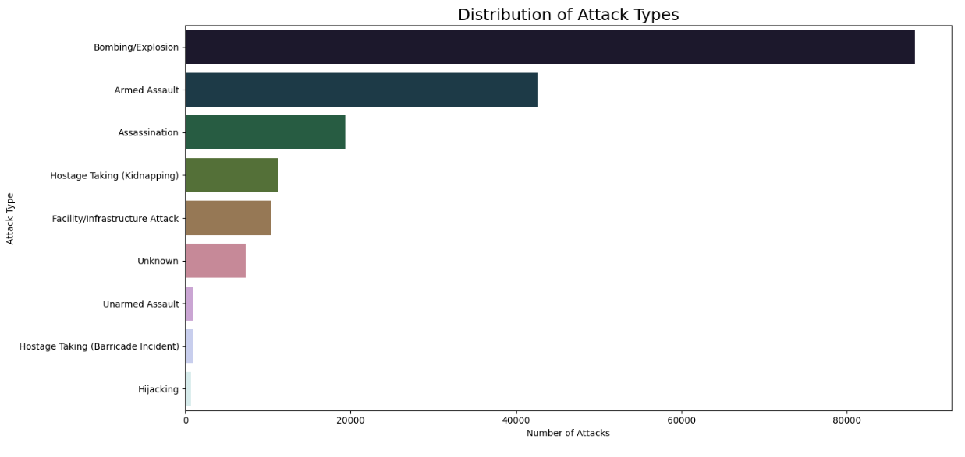
Exploratory Data Analysis (EDA) - Key Insights
Attack Characteristics
• Distribution of Attack Types
Key Insights:
Bombing/Explosion is the Dominant
Armed Assault is a Strong Second

Slide 23
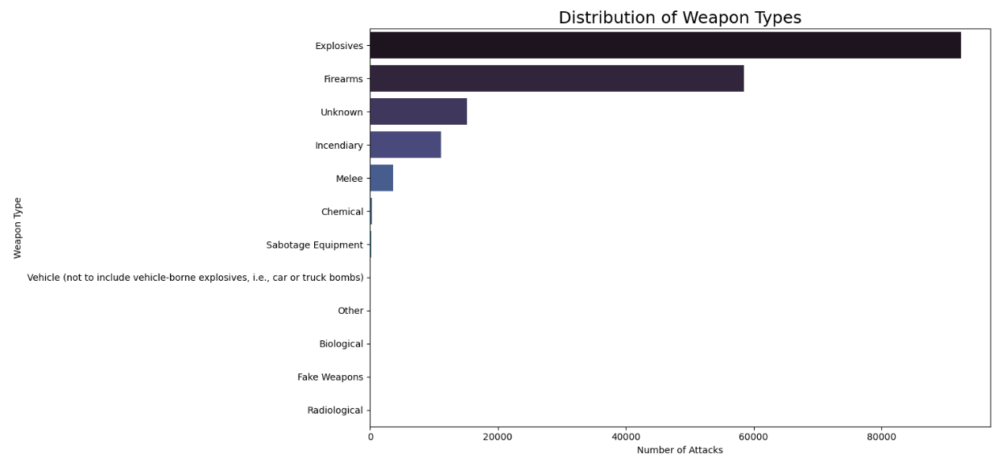
Exploratory Data Analysis (EDA) - Key Insights
Attack Characteristics
• Distribution of Weapon Types
Key Insights:
Explosives are the Overwhelmingly Preferred Weapon
Firearms are a Strong Second
Rare Use of Advanced/Mass Casualty Weapons

Slide 24
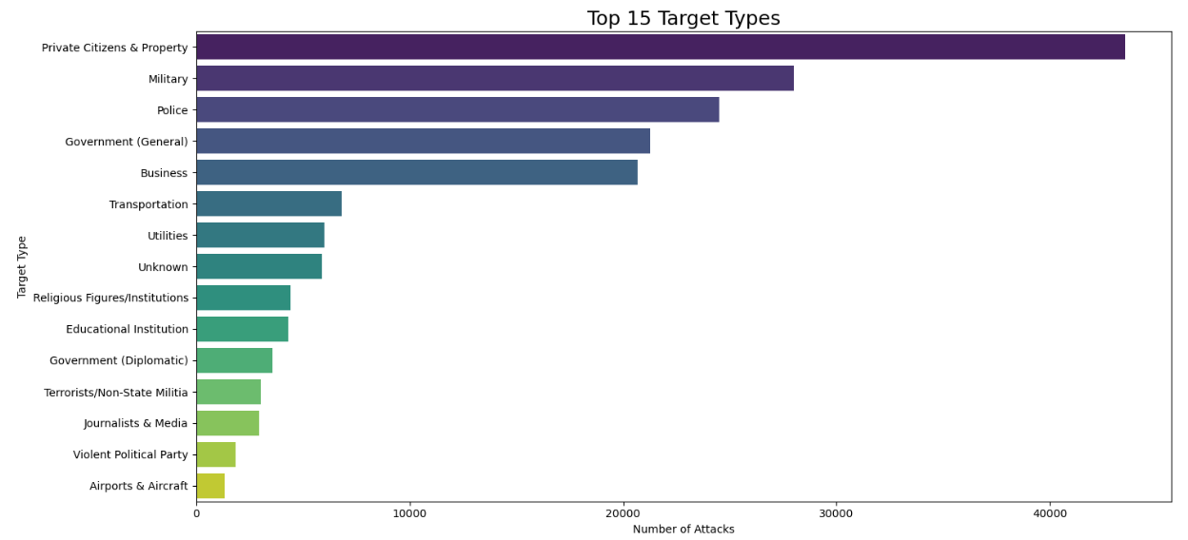
Exploratory Data Analysis (EDA) - Key Insights
Attack Characteristics
• Distribution of target Types
Key Insights:
Private Citizens & Property are the Primary Target
State Actors are Also Major Targets
Broad Range of Targets

Slide 25
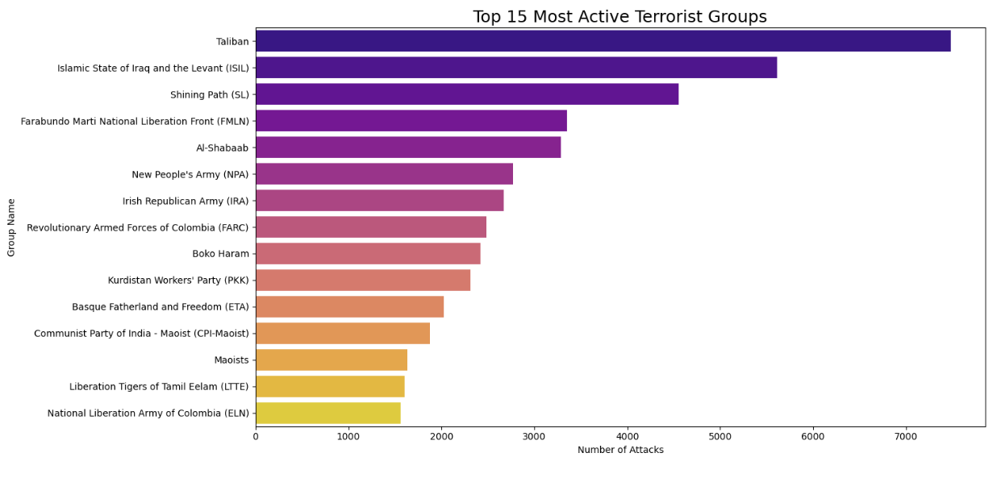
Exploratory Data Analysis (EDA) - Key Insights
Terrorist Group Analysis
Top 15 Most Active Terrorist Groups (excluding 'Unknown')
Key Insights:
Taliban is the Most Prolific Group
ISIS (ISIL) is Highly Active

Slide 26
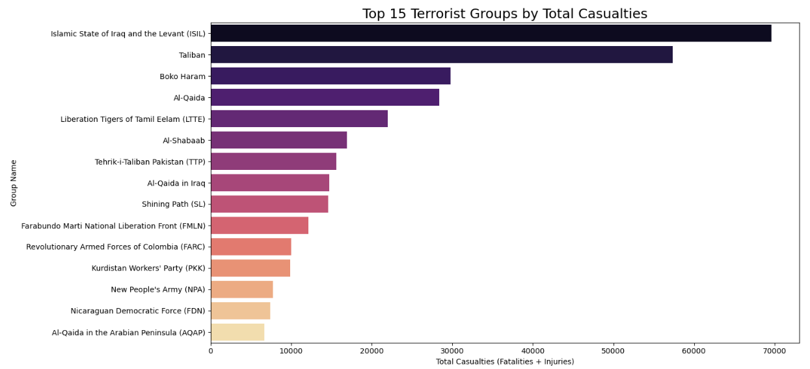
Exploratory Data Analysis (EDA) - Key Insights
Terrorist Group Analysis
Casualties by Top Terrorist Groups
Key Insights:
ISIS (ISIL) and Taliban are the Deadliest
Boko Haram and Al-Qaida Also Highly Impactful

Slide 27
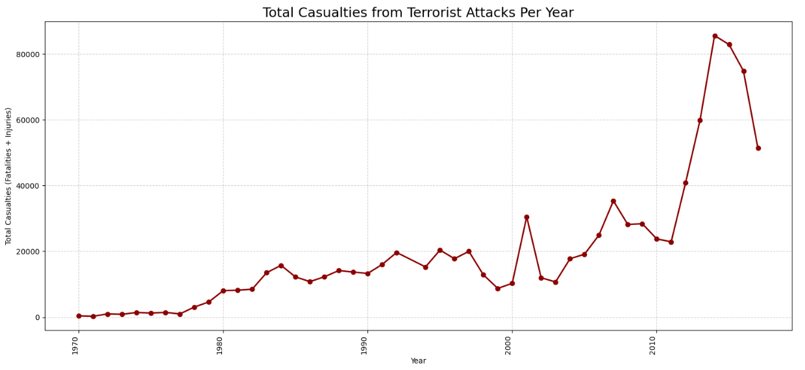
Exploratory Data Analysis (EDA) - Key Insights
Severity Analysis
Total Casualties from Terrorist Attacks Per Year
Key Insights:
Low Casualties in Early Decades
Fluctuations and Gradual Increase
Unprecedented Peak in 2014

Slide 28
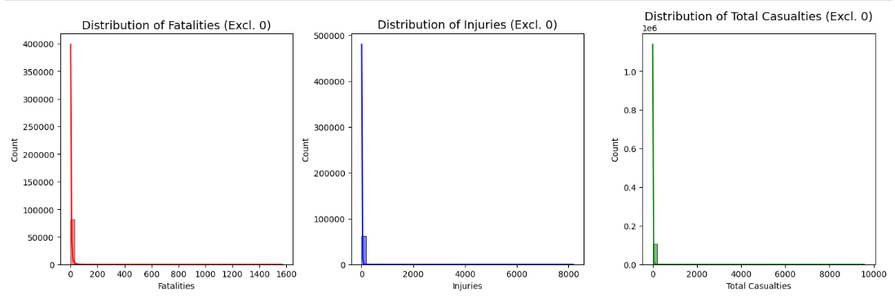
Exploratory Data Analysis (EDA) - Key Insights
Severity Analysis
Distribution of Fatalities, Injuries, and Total Casualties
Key Insights:
Extremely right-skewed distributions in all three
Most terrorism incidents result in very low fatalities/injuries/casualties (close to 0)
Very few incidents have high numbers of fatalities, injuries, or casualties, shown by long, sparse tails to the right.

Slide 29
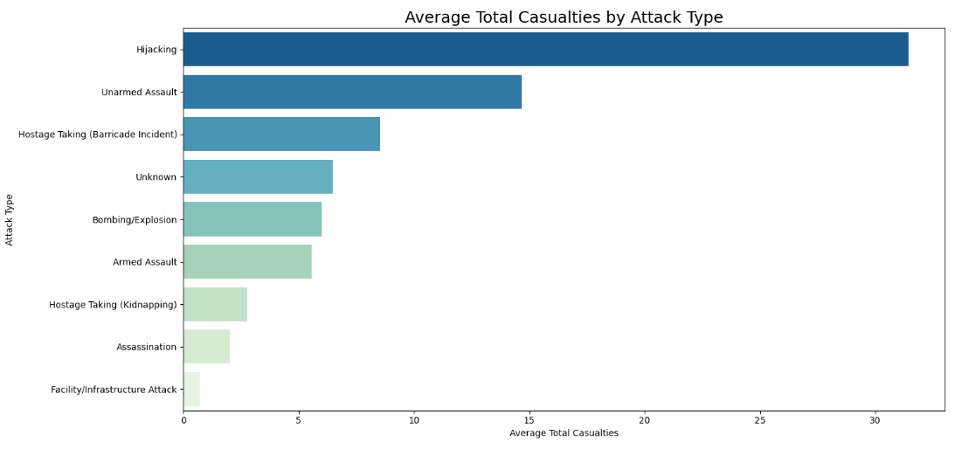
Exploratory Data Analysis (EDA) - Key Insights
Severity Analysis
Average Casualties by Attack Type
Key Insights:
Hijacking is the Most Lethal on Average
Unarmed Assault and Hostage Taking (Barricade) are also High-Impact
Bombing/Explosion and Armed Assault are Mid-Range on Average

Slide 30
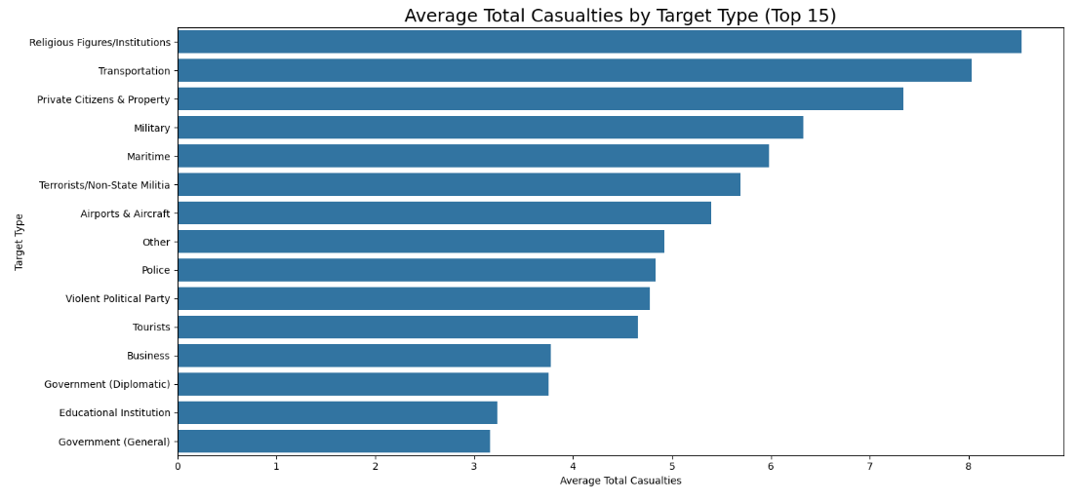
Exploratory Data Analysis (EDA) - Key Insights
Severity Analysis
Average Casualties by Target Type
Key Insights:
Religious Figures/Institutions are Most Lethal on Average
Transportation and Private Citizens are Also High-Impact
Military and Maritime Targets are Moderately High

Slide 31
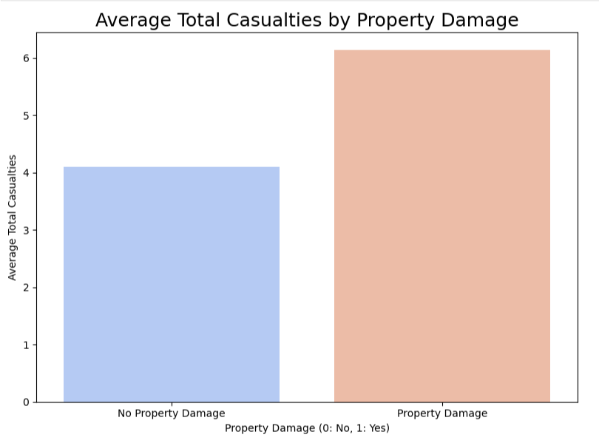
Exploratory Data Analysis (EDA) - Key Insights
Severity Analysis
Average Casualties by Property Damage
Key Insights:
Attacks with Property Damage Cause More Casualties on Average

Slide 32
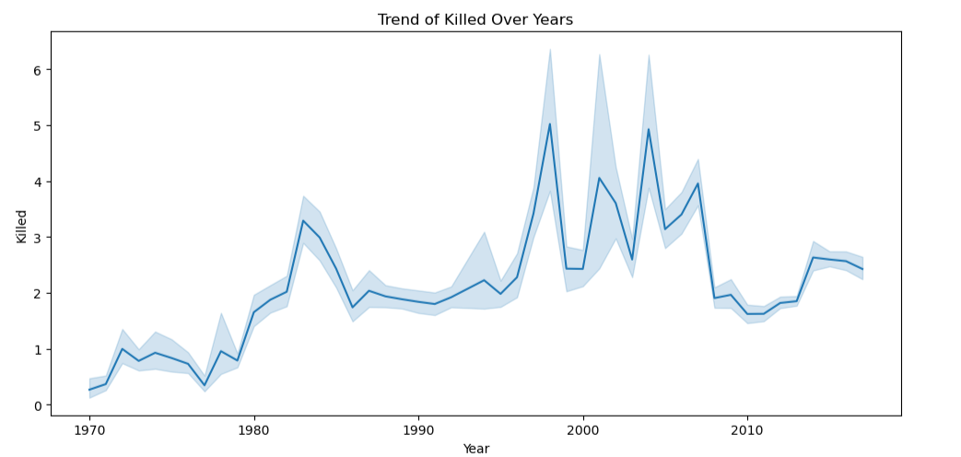
Exploratory Data Analysis (EDA) - Key Insights
Bivariate Analysis
Plotting the trend over the years for Killed.
Key Insights:
Post-2010 Stabilization (at a Higher Level)
Trend shows a general increase in the average number of people killed per attack from 1970 to 2017

Slide 33
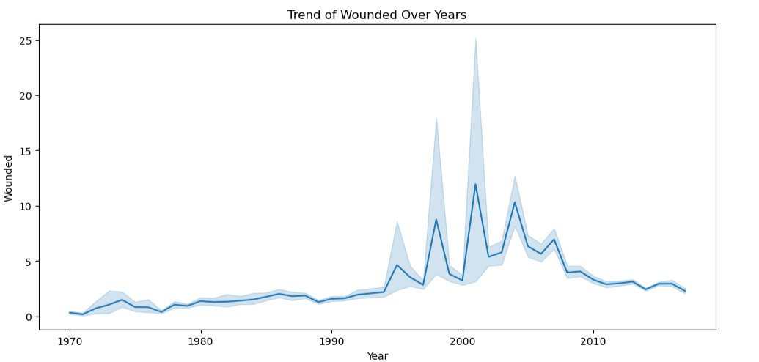
Exploratory Data Analysis (EDA) - Key Insights
Bivariate Analysis
Plotting the trend over the years for Wounded.
Key Insights:
Low Average Injuries in Earlier Decades.
Significant Spikes in the Late 1990s and Early 2000s.
Higher Volatility than Fatalities - shows even greater volatility and more extreme spikes.

Slide 34
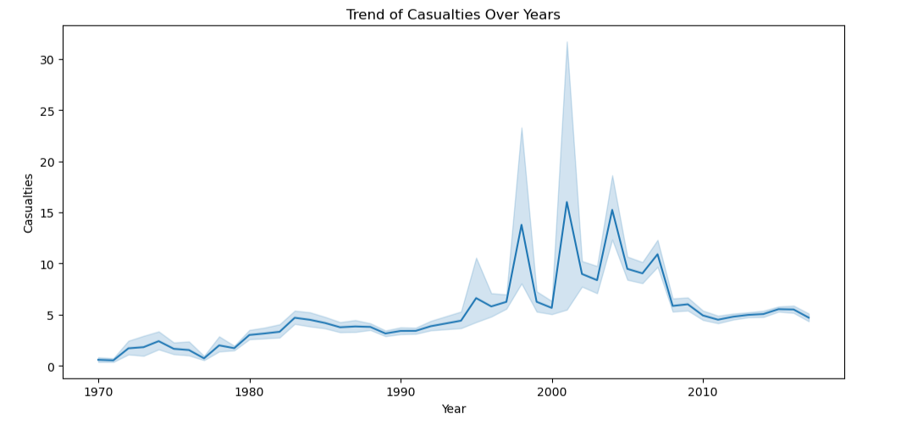
Exploratory Data Analysis (EDA) - Key Insights
Bivariate Analysis
Plotting the trend over the years for Casualties.
Key Insights:
Trend indicates a general increase in the average number of casualties per attack from 1970 to 2017.
Periods of Extreme Volatility - The graph highlights distinct periods of very high average casualties and significant variability

Slide 35
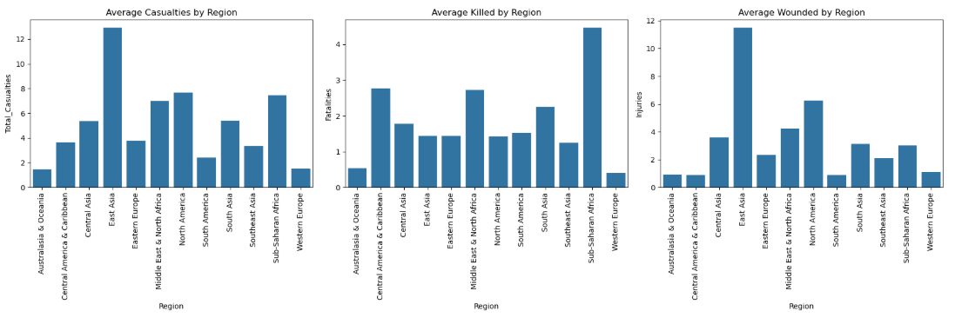
Exploratory Data Analysis (EDA) - Key Insights
Bivariate Analysis
Key Insights:
Grouping by region and calculating mean
of Casualties, Killed, and Wounded
Western Europe: Highest Average Casualties and Injuries
South Asia and Middle East & North Africa: High Average Fatalities.

Slide 36

06
Machine Learning Approach

Slide 37



Machine Learning Approach
Regression Goal
Classification Goal
Features Used
Preprocessing for ML
• Predict Total_Casualties (continuous).
• Predict Severity_Category (categorical: No, Low, Medium, High Casualties).
• Briefly list the main features selected for ML (Year, Region, Attack Type, Group Name, Weapon Type).
• One Hot Encoding
• Standard Scaler
• Explain how categories were defined (bins for casualties).

Slide 38

07
Regression Model Results

Slide 39
Results Presentation For Linear Regression
Metric | Value
MAE | 4.94
MSE | 2857.94
RMSE | 53.46
R2 | 0.002 (approx. 0.00)

Slide 40
Results Presentation For Random Forest Regresser
Metric | Value
MAE | 4.74
MSE | 2682.88
RMSE | 51.80
R2 | 0.06

Slide 41


Interpretation
Acknowledge the low R2 scores
Explain that low R2 means the model explains only a small percentage of variance.
Highlight that linear models performed even worse (negative R2).

Slide 42

Key Takeaway
The most important thing to remember is that predicting the exact number of people killed or injured in a terrorist attack is extremely difficult.
Even with all our data and smart computer models, terrorism is just too unpredictable. Many things that happen during an attack are random or depend on human choices in the moment, and we can't put those into our data.
So, while we can find patterns and get a general idea of risk, getting the exact number right every time is a huge challenge because of how chaotic and complex these events are.

Slide 43

08
Classification Model Results

Slide 44
Results Presentation
Metric | Value
Accuracy | 0.63
Precision | 0.62
Recall | 0.63
F1-Score | 0.63

Slide 45
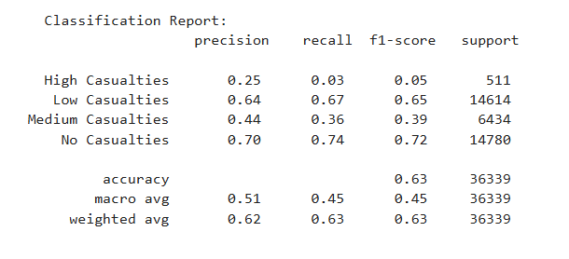
Classification Report

Slide 46

Detailed Interpretation
Overall Accuracy (e.g., 0.63 or 63%).
Discuss performance for 'No Casualties' (likely high precision/recall).
Discuss 'High Casualties' performance (Precision: 0.25, Recall: 0.03, F1-Score: 0.05) – explain the challenge of predicting rare, high-impact events due to class imbalance.

Slide 47

Key Takeaway
Classification offers a more practical categorical risk assessment, but accurate prediction of high-severity events remains a significant challenge requiring further focus.

Slide 48

09
Conclusion

Slide 49

Summary of Key Findings
1
First, from our Exploratory Data Analysis, we've clearly identified significant trends. We saw a dramatic escalation of global terrorism peaking in 2014 in both attack frequency and total casualties. Geographically, the Middle East & North Africa and South Asia remain the primary hotspots, with countries like Iraq and Pakistan being most affected. In terms of tactics, Bombings/Explosions and Armed Assaults are the dominant attack types, often targeting private citizens and military personnel, utilizing Explosives and Firearms as primary weapons. Groups like the Taliban and ISIL are consistently the most active and cause the highest human impact.

Slide 50
Summary of Key Findings
2
Second, our Machine Learning models provided crucial insights into the challenges of prediction. For regression, we found the difficulty of predicting exact casualty numbers is inherent due to the extreme data skewness and the unpredictable nature of real-world events, as reflected in our low R-squared scores. However, the potential of classification is promising. While our model showed good accuracy for lower severity events, it highlighted a critical challenge: the low recall for 'High Casualties' due to class imbalance. This means, while classification offers a more actionable framework, reliably identifying those rare, devastating attacks requires further dedicated work.

Slide 51
Summary of Key Findings
3
Finally, despite these challenges, our project strongly emphasizes the immense value of data-driven insights for counter-terrorism and preparedness. By understanding when, where, how, and by whom attacks are most likely to occur, and the typical impact profiles, we can inform more targeted strategies. This includes better resource allocation, developing specific countermeasures against prevalent tactics, and enhancing rapid response capabilities to mitigate the human cost of terrorism.

Slide 52

10
Future Work

Slide 53







Actionable Next Steps
Hyperparameter tuning.
Addressing class imbalance [SMOTE(Synthetic Minority Over-sampling Technique), class weights].
Exploring alternative regression models (zero-inflated, two-part).
Feature Importance analysis.
Temporal validation.
NLP for Summary and Motive fields.
Interactive Dashboard development.
Deeper dive into ethical considerations.

Slide 54

11
Q&A / Thank You Slide

Slide 55

Q&A / Thank You Slide
1
"Thank You"
2
"Questions?"
3
Team Name and Members again.

Slide 56

Thank You

